Slide 1


Real Estate
Data Analysis
Presented by :
Mentor : VenkataSbilla Sir
Team : ZOOKEEPER
Team Lead : Dheeraj Soni (30080254)
Team Member: Abhishek Tiwari (30080269)
Team Member: Kratika Ghadge (30080319)
Team Member: Mrunal Thakre (30080261)

Slide 2






Project Overview & Agenda
Analyzed a large-scale real estate dataset to uncover pricing trends, construction patterns, and amenity influences using Big Data tools like PySpark, Spark Scala, and Hive.
This presentation covers:
🎯 Objective & Problem Statement
🛠️ Technologies Used
🏗️ Big Data Architecture
🧹 Data Cleaning Process
👥 User Stories
🧠 Key Insights & Conclusion

Slide 3



Objective and Problem Statement
In today’s data-driven world, the real estate sector still struggles with fragmented insights and inefficient methods to evaluate property characteristics at scale.
Objective:
Analyze real estate data using PySpark, Spark Scala, Hive, and Power BI
Extract trends by property type, price, year, features, and location
Visualize insights for strategic decision-making
Challenges:
Identifying high-value property types
Understanding price shifts over time
Comparing features and locality preferences
Solution:
Leverage Big Data tools to turn raw property data into actionable insights.

Slide 4





Technologies and Big Data Architecture
Source
Storage
page 6
Processing & Analysis
Reports

Slide 5
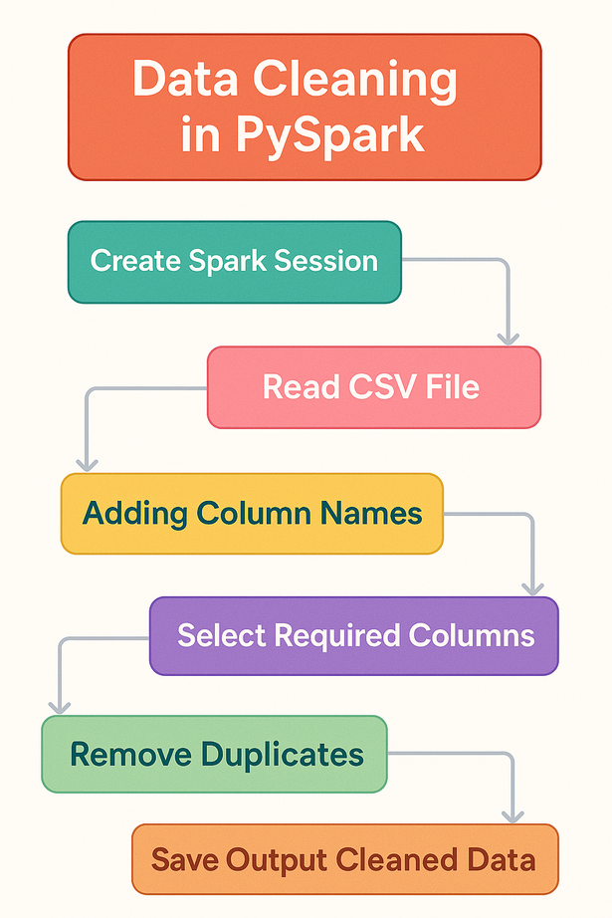
Data Cleaning
Entry point to any Spark functionality.
Load raw data from source.
Assign meaningful column names to raw data.
Drop irrelevant features to focus on necessary ones.
Ensure uniqueness and clean redundancy.
Store the clean dataset for downstream use.

Slide 6
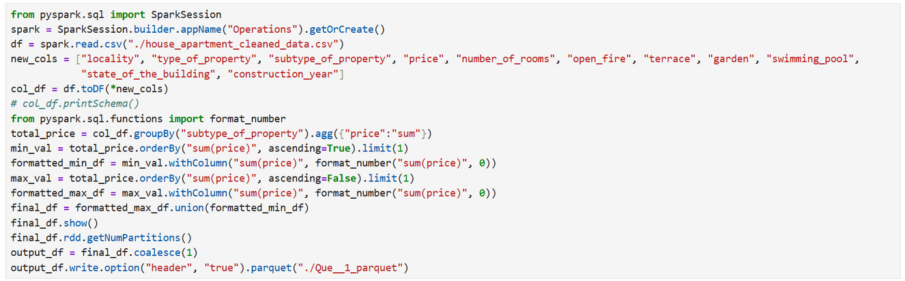
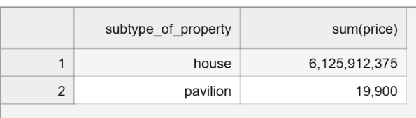
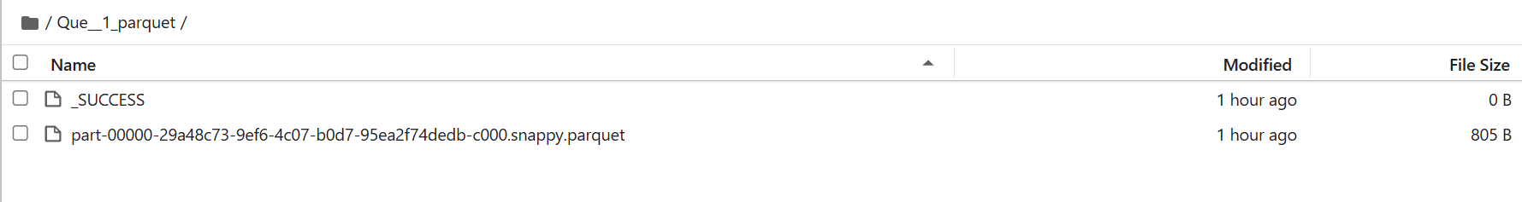
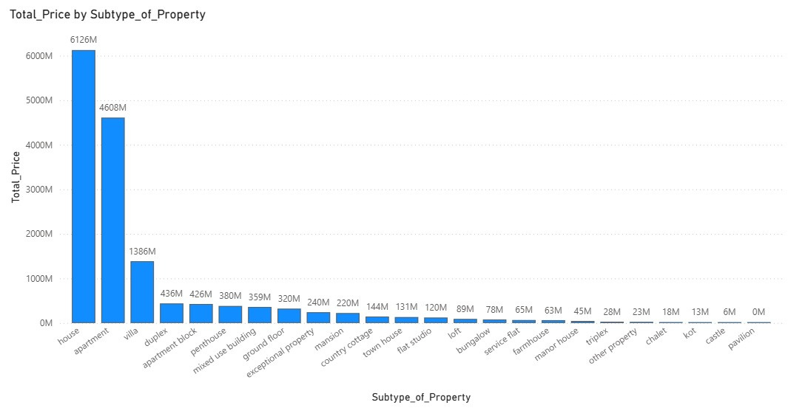
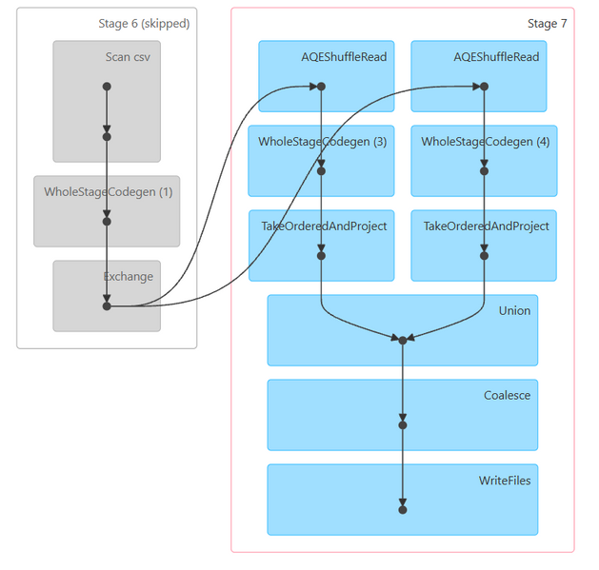
1. Total price of subtype_of_property, subtype of property which have highest and which have least price
page 5

Slide 7
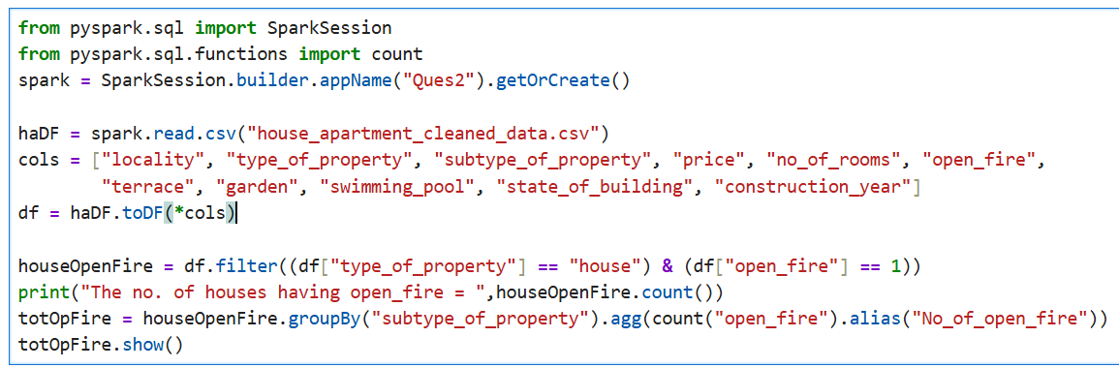
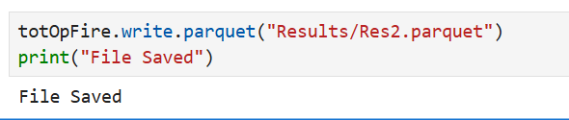
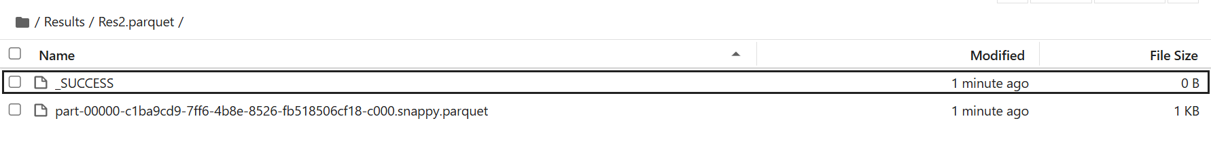
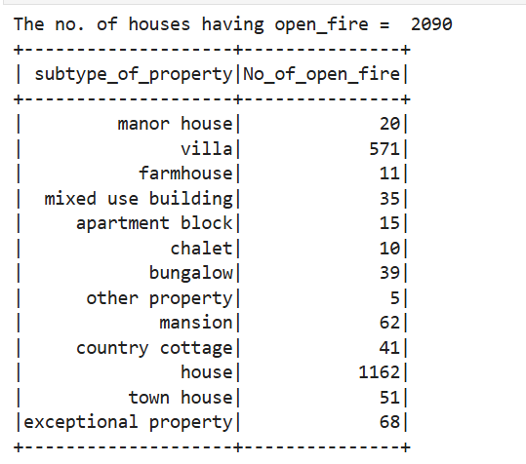
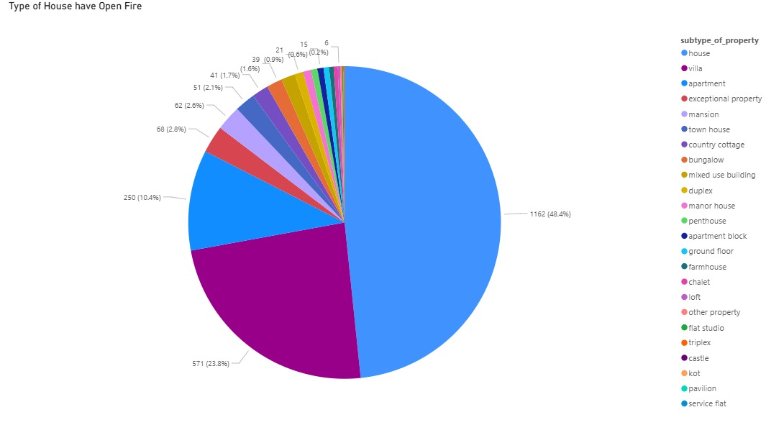
2. How many type of house have a open_fire and which type of house has many open_fire
page 5

Slide 8
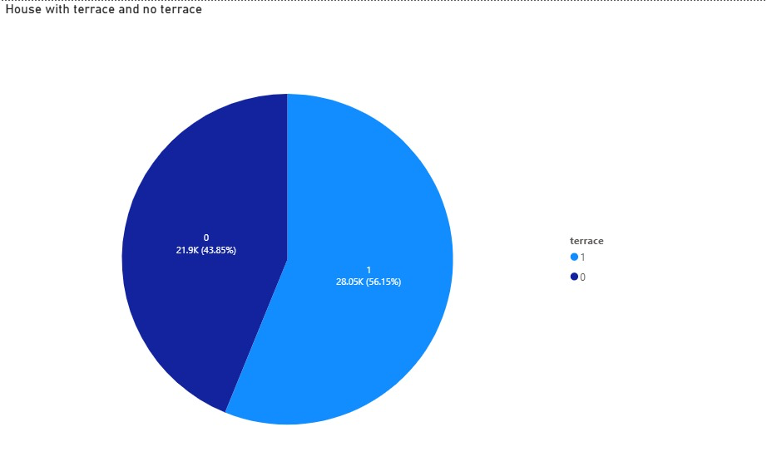
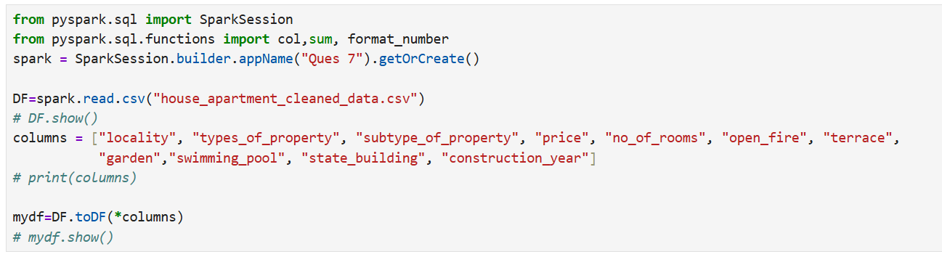
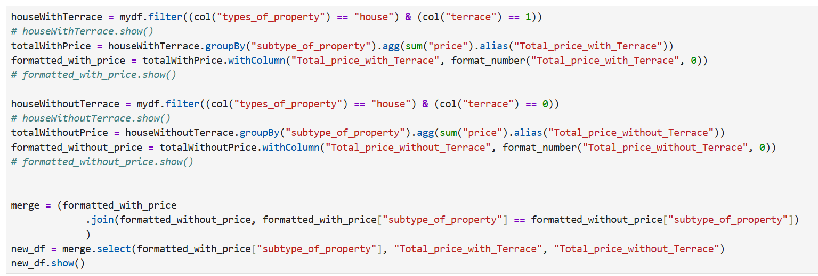
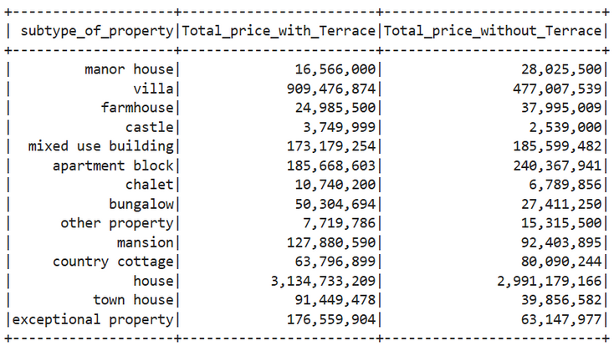
3. Which type of houses has terrace and which type of house has no terrace and retrieve the prices

Slide 9
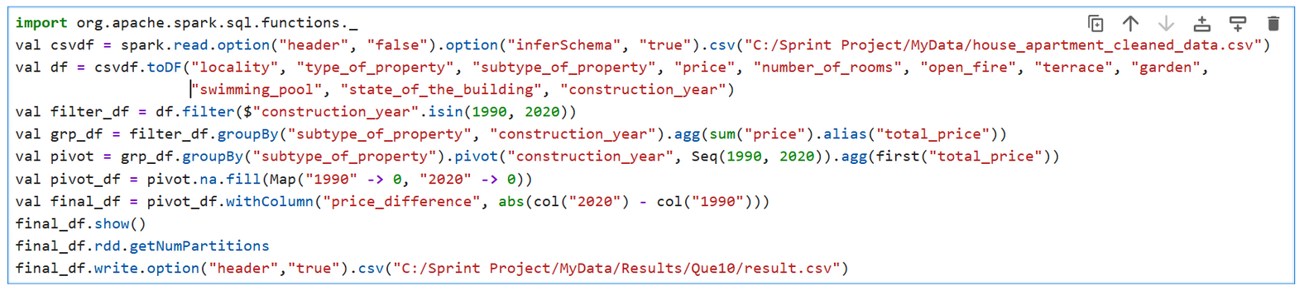
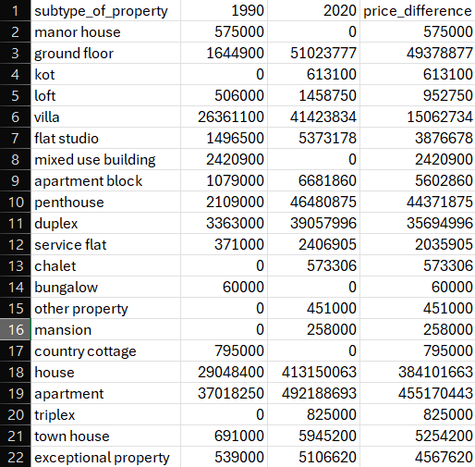
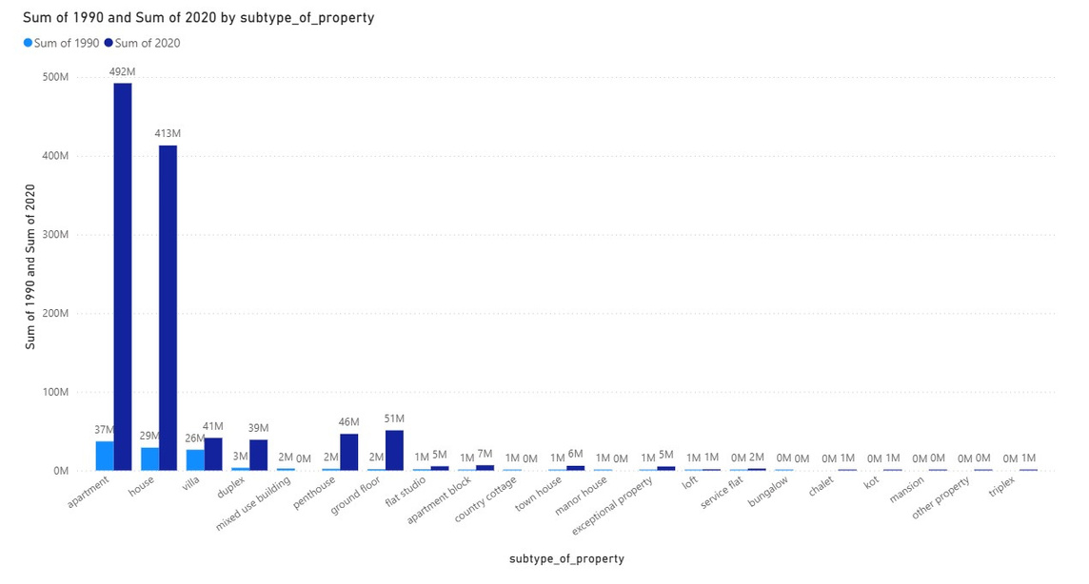
4. What are the type of sub properties in the year of 1990 and 2020 and what is the price difference between the price of 1990 and 2020
page 5

Slide 10
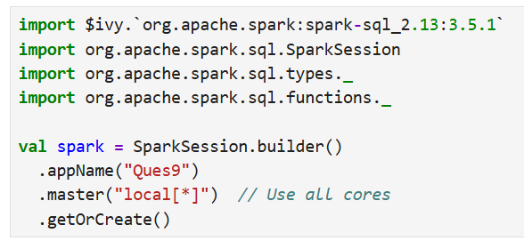
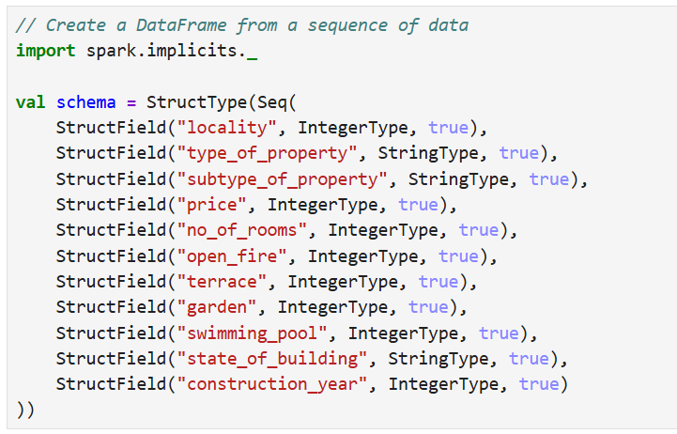
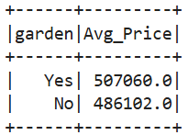
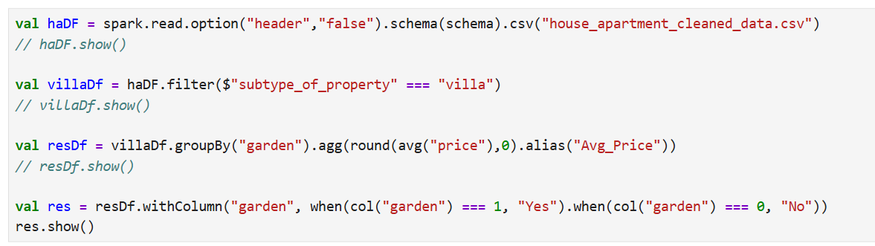
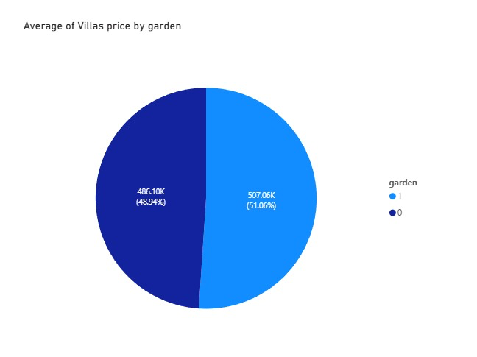
5. What is the average of the villas price by garden wise
page 5

Slide 11
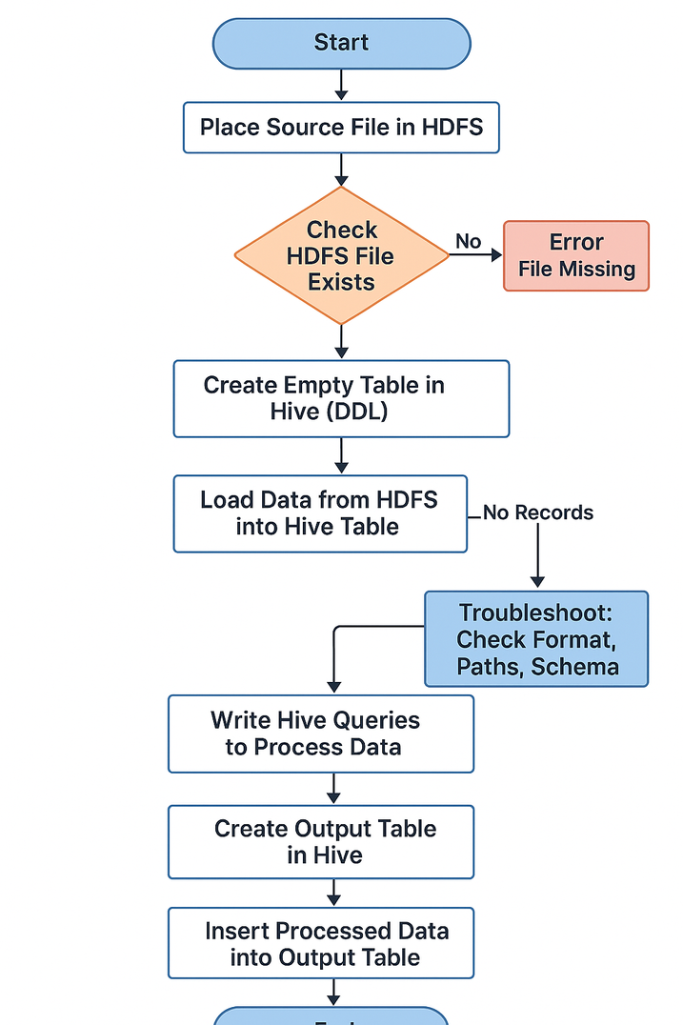
6. What is the all total price of villa and house and find the difference between the 1990 and 2020 (Using Hive)
hadoop fs -mkdir /user/training/RealEstate
hadoop fs -put /home/training/Desktop/house_apartment_cleaned_data.csv /user/training/Realestate
hadoop fs -ls /user/training/RealEstate
hive> {Create table house_apartment}
hive>load data inpath ‘RealEstate/house_apartment_cleaned_data.csv into table house_apartment
hive> select * from house_apartment
page 5
SELECT
subtype_of_property,
construction_year,
SUM(price) AS total_price
FROM
house_apartment
WHERE
subtype_of_property IN ('house', 'villa')
AND construction_year IN (1990, 2020)
GROUP BY
subtype_of_property, construction_year;
SELECT
SUM(CASE WHEN construction_year = 1990 THEN price ELSE 0 END) AS total_price_1990,
SUM(CASE WHEN construction_year = 2020 THEN price ELSE 0 END) AS total_price_2020,
ABS(SUM(CASE WHEN construction_year = 2020 THEN price ELSE 0 END) -
SUM(CASE WHEN construction_year = 1990 THEN price ELSE 0 END))
AS price_difference_2020_vs_1990
FROM
house_apartment
WHERE
subtype_of_property IN ('house', 'villa')
AND construction_year IN (1990, 2020);

Slide 12
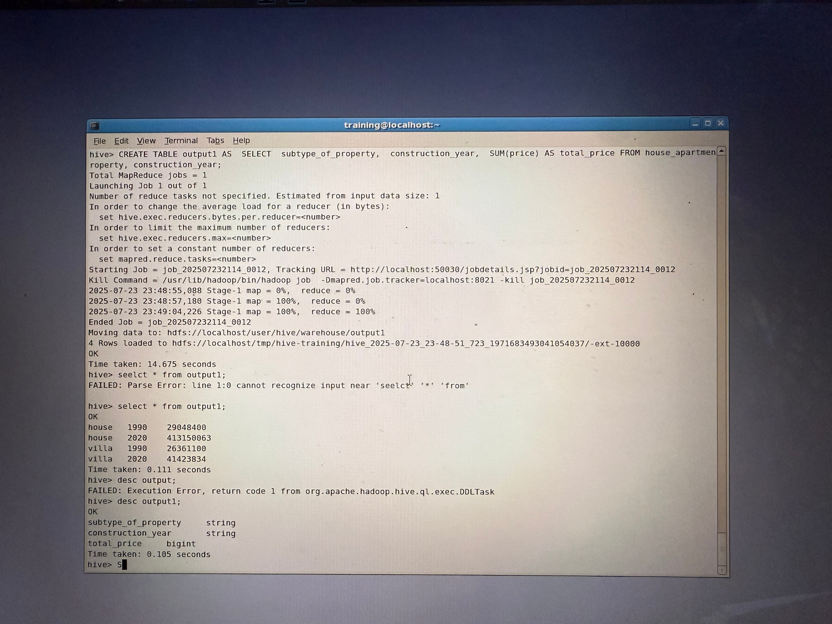
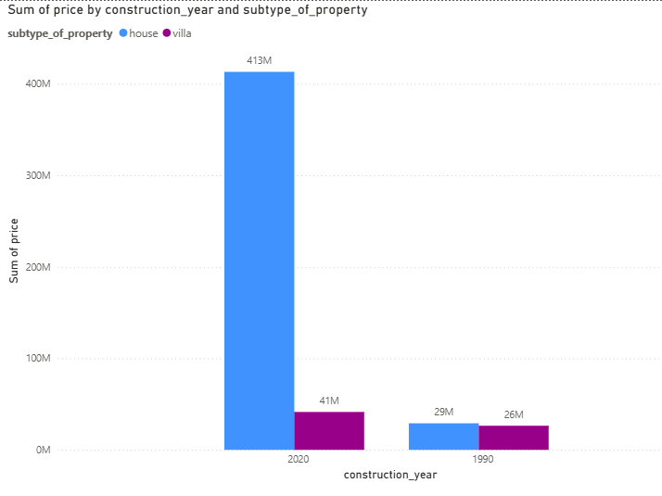
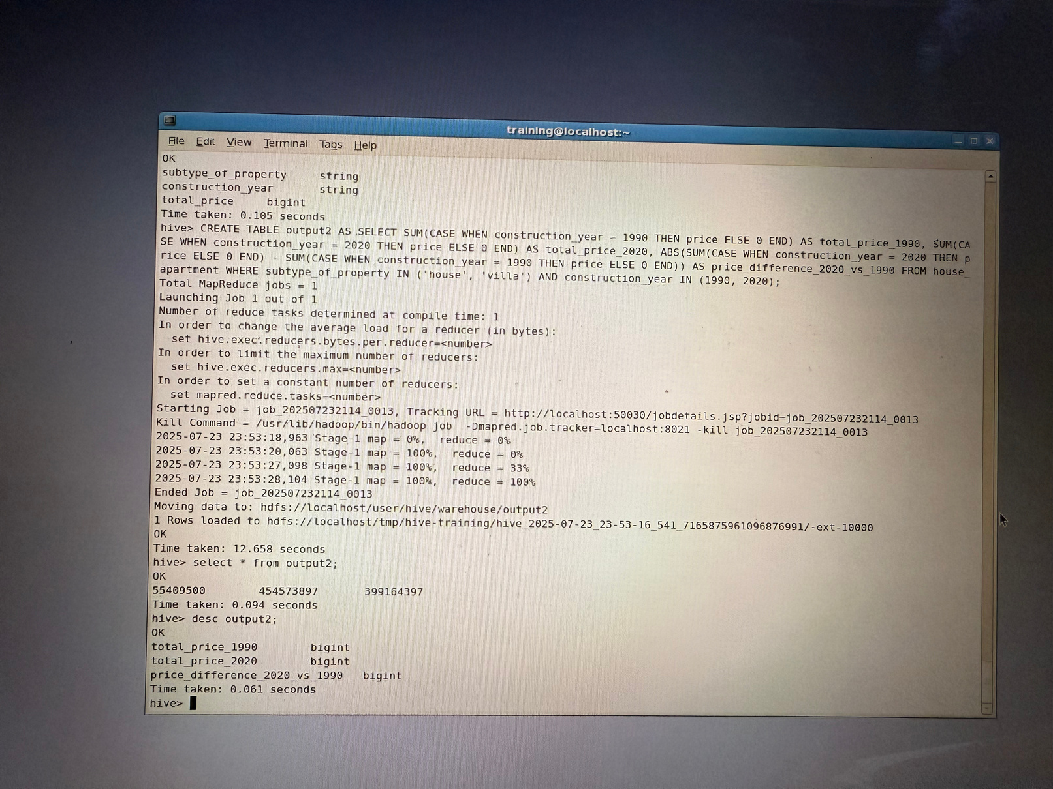
6. What is the all total price of villa and house and find the difference between the 1990 and 2020

Slide 13

Key Insights & Findings
Leveraged PySpark, Spark Scala, and Hive to solve real-world real estate problems
Discovered key patterns such as:
🏠 Most expensive & cheapest property subtypes
📍 Localities with highest number of villas
📈 Price variation across years & renovation status
🛋️ Distribution of features like open fire, terrace, garden, and pool
Big Data tools enabled efficient handling of large datasets and extraction of actionable insights

Slide 14

Acknowledgement
We would like to extend our heartfelt gratitude to Venkat Sir for his exceptional guidance and dedication. Thank you for teaching us so many big data technologies in such a short span of time. Your expertise and patience have been invaluable to our learning journey.
page 15

Slide 15
Thank You.
Any Questions?
page 15

